Slide 1
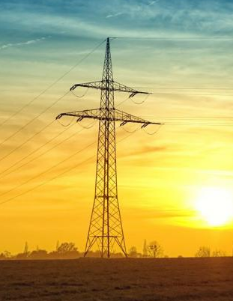
AI-Driven Power Pole Inspections
Case Study

Slide 2
Overview
Data
AI Pipeline (Focus)
Tools
Future

Slide 3
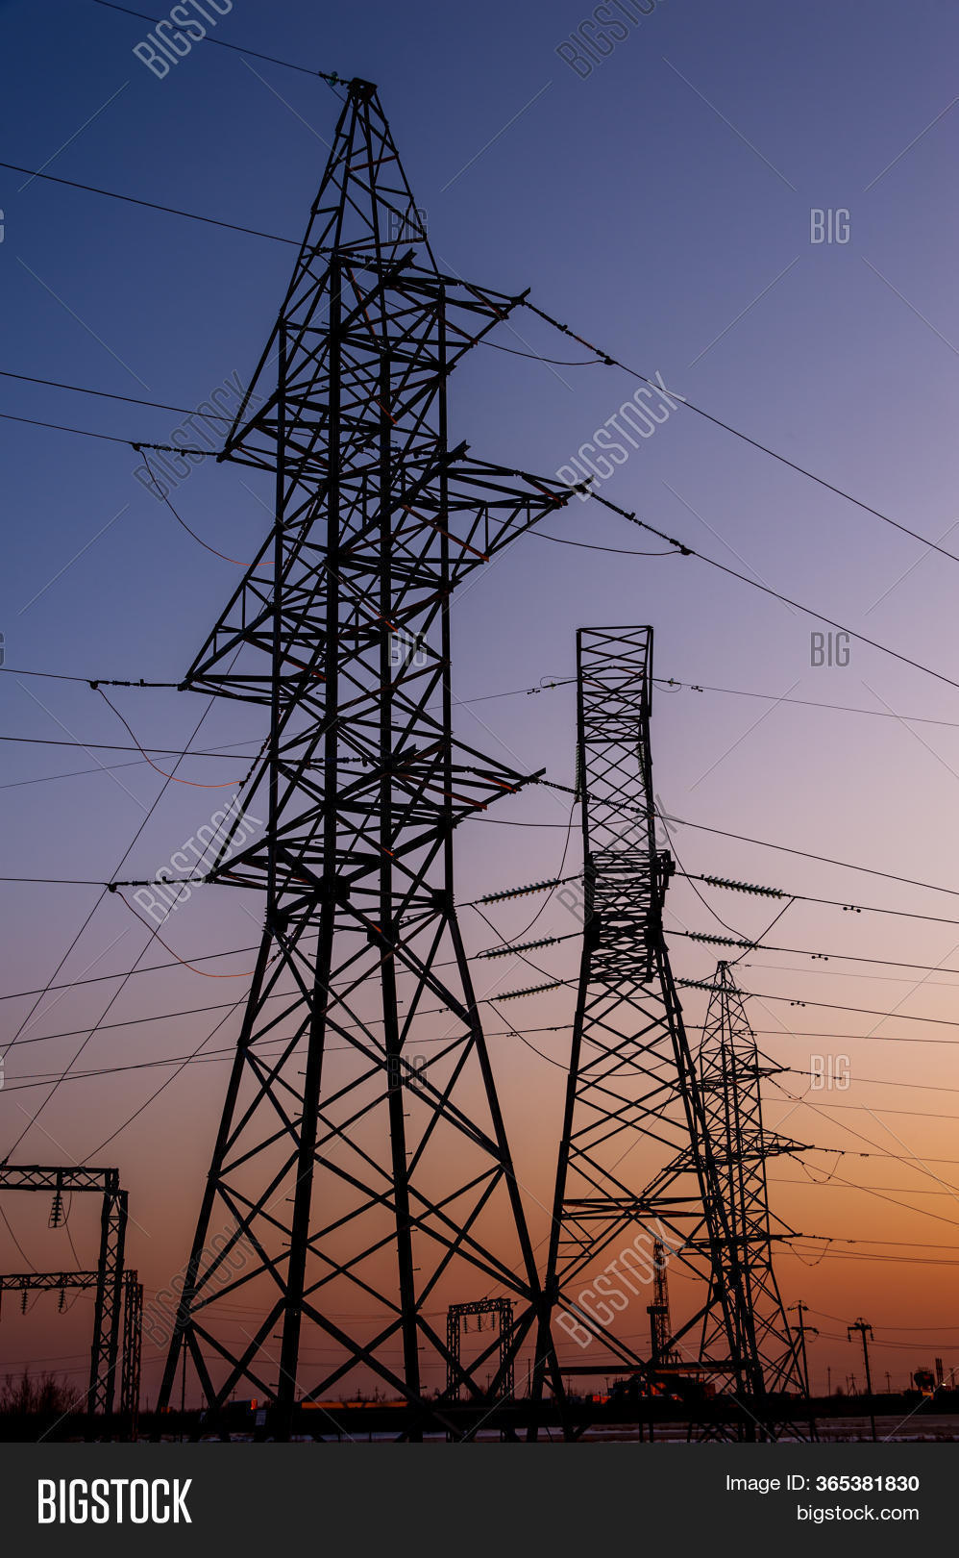
Data
Videos or images? Image pose estimation is difficult with repetitive structures (metal power post). Videos are better in this case.
Multiple images of the power post from different angles and distances. Close up images of each point of interest? (pole cap, insulator, etc..)
IMU (Accelerometer, Gyroscope, Magnetometer) of the drone
Infrared images? Maybe some defects (like rust) don’t reflect infrared?
Do we need 3D? Photogrammetry? 3D Sensors? Attention: very fine structures!
Camera intrinsics, camera poses, sparse point cloud with observations (and dense 3d mesh reconstruction). This can be extracted from many photogrammetry systems and should preferably done by the user (This way we know the camera path was trackable and reconstructable. Detecting a defective recording would be too late on our own server/pipeline. Less computations on our side).
Do we have a map of all power posts with their location and maybe meta data (#isolators, material, #attachments, #cables, etc.). Can we get it? Google maps or OSM (OpenStreetMaps)?

Slide 4
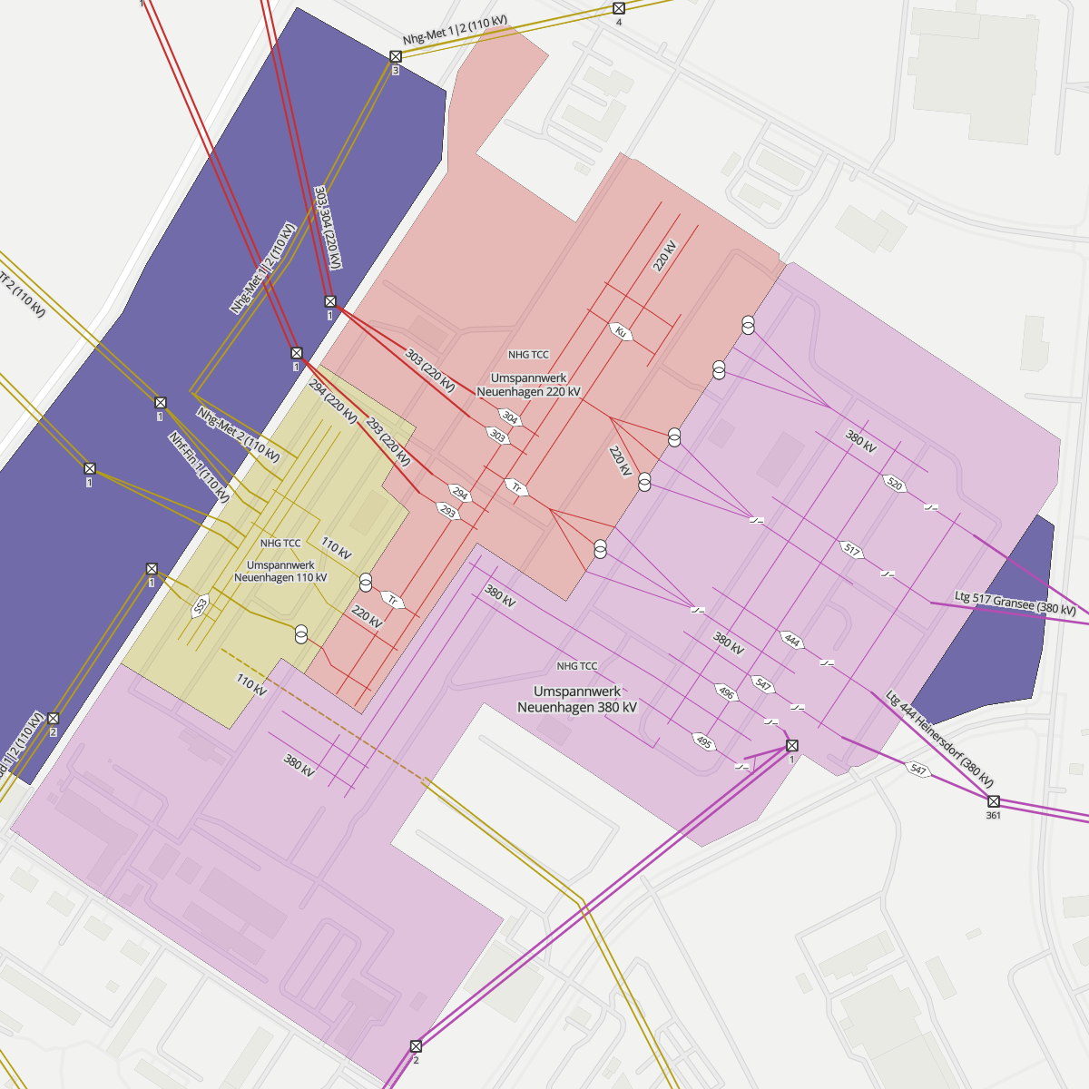
Gathering Data
Straight line along the wires (+ 360° for each post at different distance) (+ close up of attachements)
Cloudy, no direct sun, no wind, no rain, no snow
How close can we get to the post and the attachements?
Highest possible resolution
Is it possible to make annotations during the drone capture? (e.g. make image classifications by talking into your mobile device which is connected to the drone)
Fully automated drone flight and capture? Now? Future?
Import power post data from OSM, GoogleMaps

Slide 5
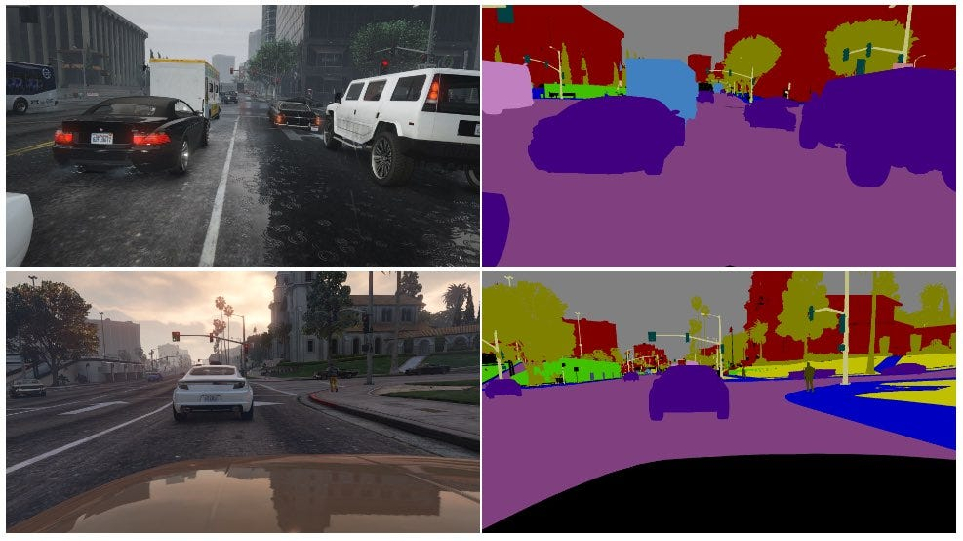
Gathering Data – Synthetic Training Data
Just one big main object with a rather empty environment
Easy Materials, wood, metal, concrete
Adding defects with textures und UV‘s
100% correct and automated ground truth data
Generate as much data as you want > 1000000 power posts in different environments and conditions
Very realistic rendering in Unreal Engine

Slide 6
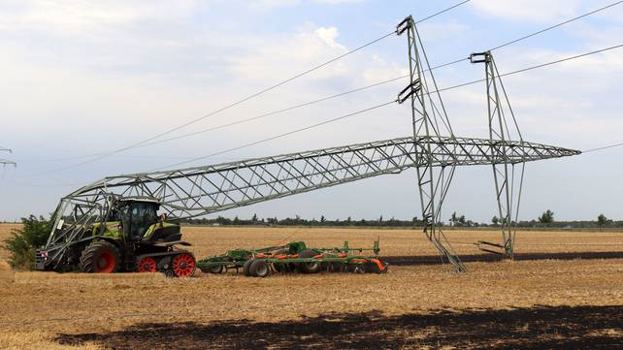

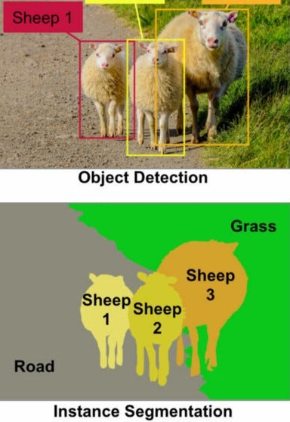
General Problems and Questions
All or nothing: Either all required data (defects, etc.) is collected with the required accuracy and reliability or a manual inspection is necessary anyway.
What is important and how detailed does the automated inspection have to be:
Yes, anomaly detected. Please plan a manual inspection.
Segmented and classified data in 2D and 3D for each POI with meta data and many images.
What difference does that make to the response/reaction? Comparison: Autonomous Driving and End to End learnin
Customer: We want pixel masks! Why? What are you going to do with that Pixel? How important are pixel masks?

Slide 7
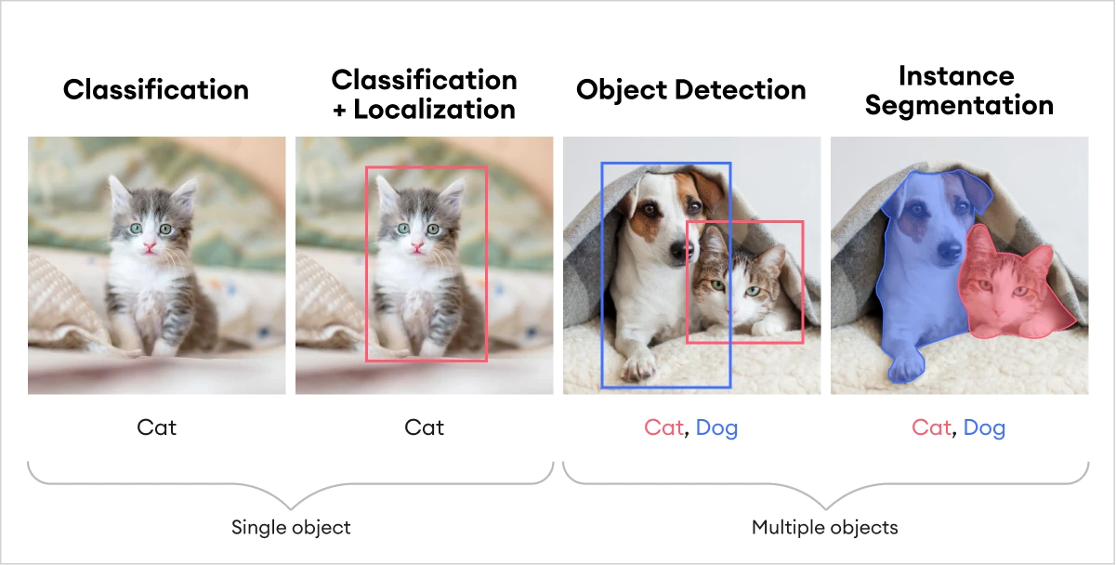
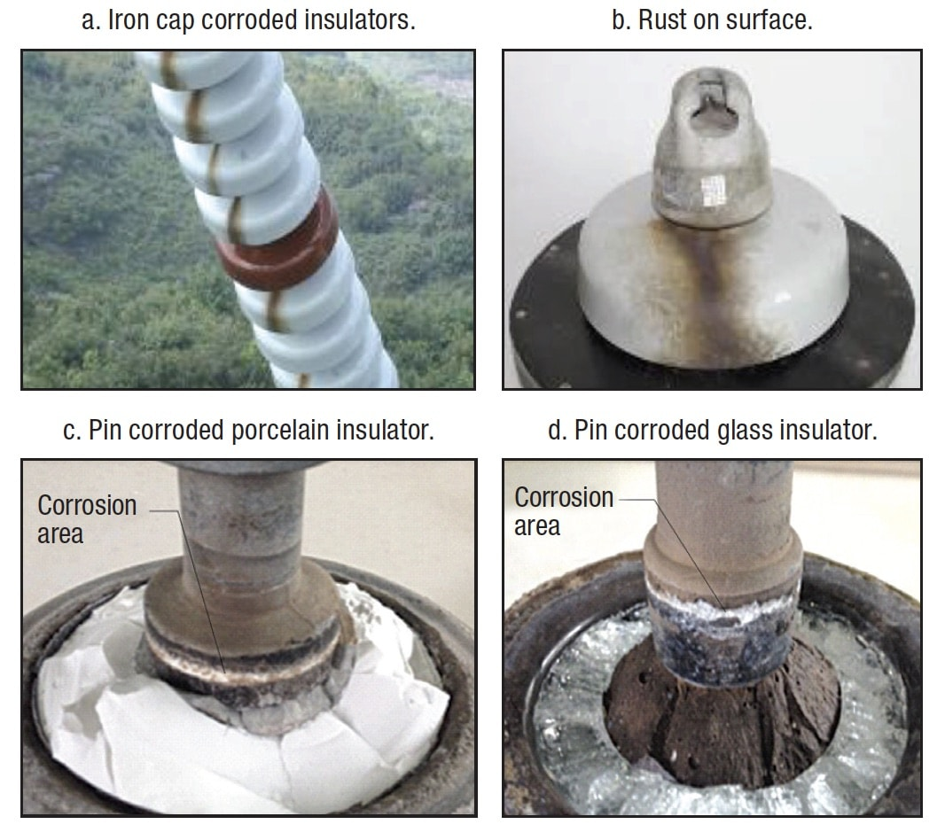
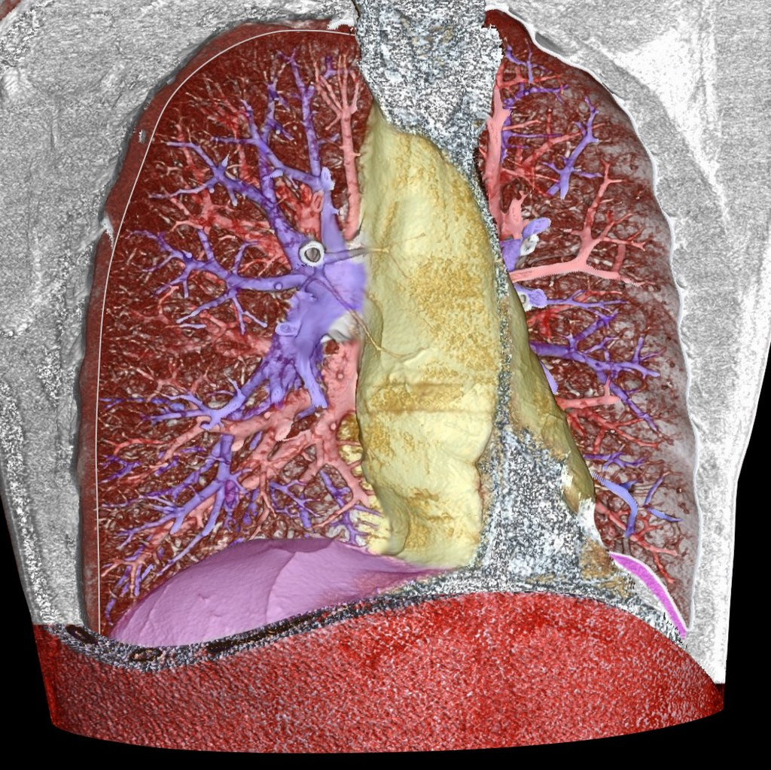
Classification vs Detection vs Segmentation
Image classification: CNNs, AlexNet, VGGNet, ResNet
Object detection: Faster R-CNN, YOLO (You Only Look Once), and SSD (Single Shot MultiBox Detector), Mask R-CNN)
Image segmentation, panoptic segmentation (instance + class): Unet, EfficientPS
Object detection has problems with complex and overlapping structes which is probably not the case for power poles
Neural network complexity (sensitivity, inaccuracy): Classification < Detection < Segmentation
Labeling complexity, effort, costs: Classification < Detection < Segmentation
Bei classifiction, welche pixel haben am meisten zur classification beigrtragen

Slide 8
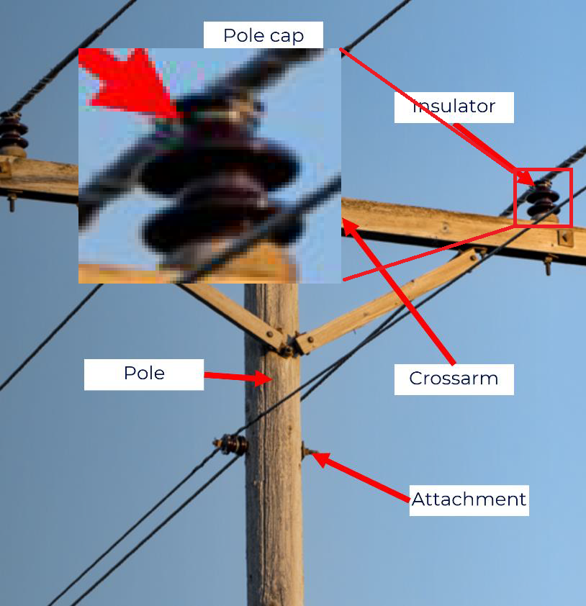
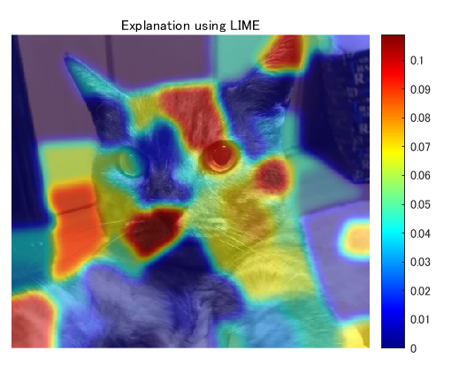
Classification vs Detection vs Segmentation for Power Poles
Close up images -> Classification (Defect classes)
Take close up images directly with drone or crop from larger image after object detection (or segmentation)
Explainable image classification: It‘s possible to make inferences about which pixels contributed most to the resulting class.

Slide 9
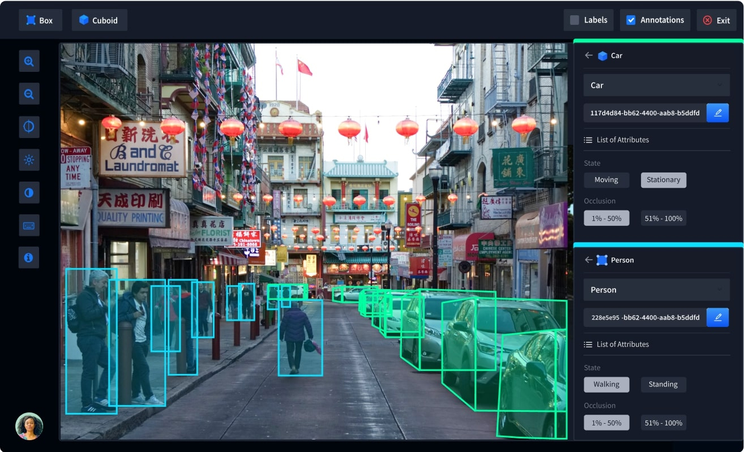
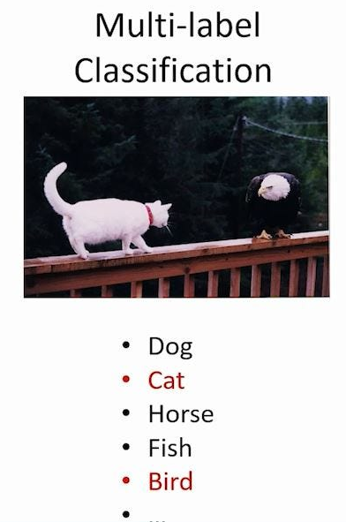
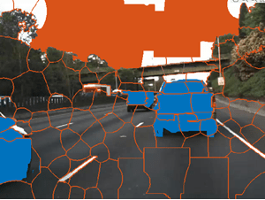
Classification vs Detection vs Segmentation – Annotations and Labels
Labeling complexity, effort, costs: Classification < Detection < Segmentation

Slide 10
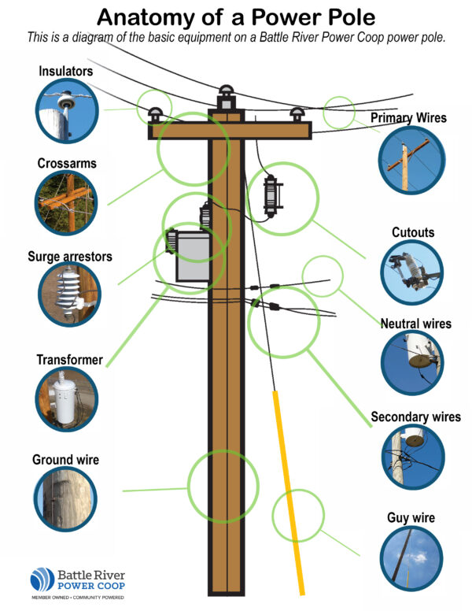
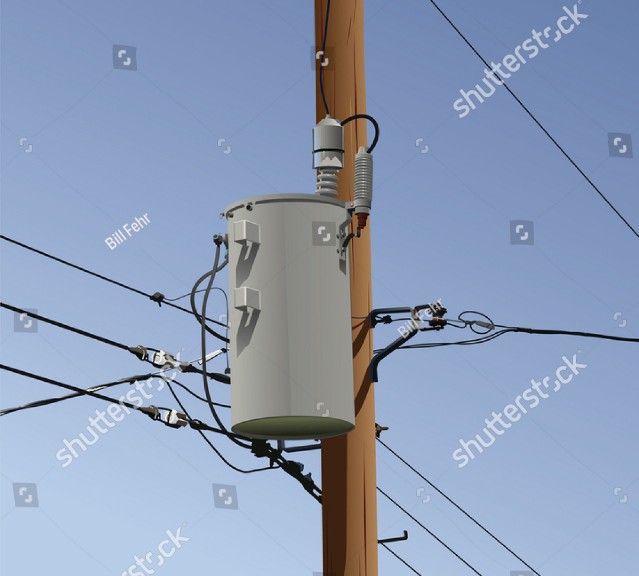
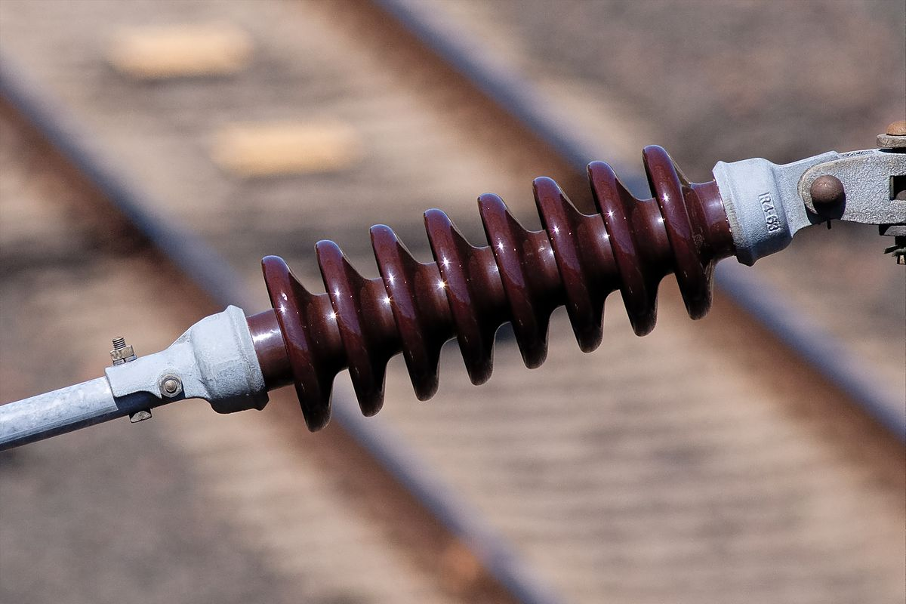
Object Classes and Defect Classes
Object classes:
Pole
Crossarm
Pole cap
Insulator
Cable
Attachements
…
Defect classes:
Cracks
Chippings
Burn marks
Rotting
Rust
…
Object classes (detection or segmentation):
Pole
Crossarm
Pole cap
Insulator
…
Defect classes (multi-class classification)
Pole defect classes:
Cracks
Chippings
Rotting
Crossarm defect classes:
…
Pole defect classes:
…
Insulator defect classes:
Chippings
Burn marks
Rust
2 models (1 object class model, 1 defect class model)
Object detection or segmentation
Can process any image, no matter of angle and distance
Very general defect models (+/-), lots of data to train (+), doesn‘t depend on any object type(+), probably less accurate and robust(-)
1 + #Object classes models:
1 object detection or segmentation model for object classes
1 specific multi-class defect image classification model for each object type. Not every defect can appear on each object (no rust on wood etc).
Object detection on all images, classification on close ups (from crops or raw)
Specific defect models (+), less data to train but more precise(-/+), depends on objects type and new objects require new model (-), more accurate and robust (+)

Slide 11
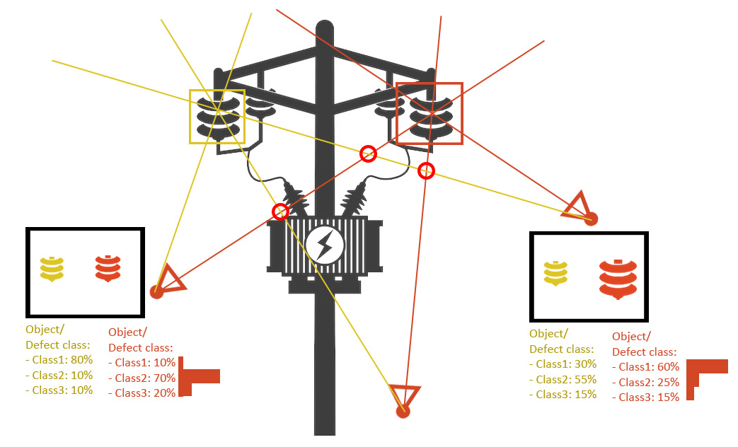
Data Assocation, Data Fusion and 3D Localization (with camera poses)
Input: multiple images from different angles and distances to the power pole with camera poses (and maybe a sparse point cloud with oberservations)
Run models on each image
Associate data of the same object from multiple images with computer vision (cluster intersection points)
Fuse probability distributions of object and defect classes to increase reliability, robustness, accuracy

Slide 12
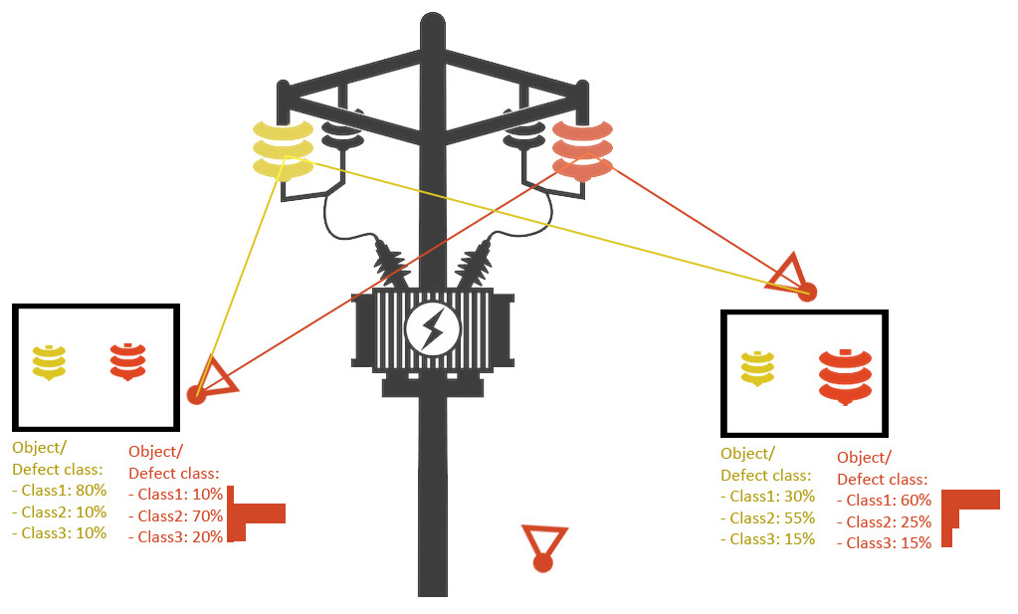
Data Assocation, Data Fusion and 3D Localization (with 3D reconstruction)
Input: multiple images from different angles and distances to the power pole with camera poses (and maybe a sparse point cloud with oberservations)
Run models on each image
Associate data of the same object from multiple images by backprojecting the pixels into the scene and onto the 3d surface. Then this surface can be projected into other images again to find correspondences.
Attention: 3d geometry might be wrong or missing. Especially for small and thin structures.
Fuse probability distributions of object and defect classes to increase reliability, robustness, accuracy

Slide 13
Most important questions
Close-ups during capture? (maybe with voice labels)
No camera poses, camera poses, and mesh?
Object classes, defect classes?
Classification, detection, segmentation?
Option 2
Camera poses and 3d reco
2 segmentation models
Pixel perfect labeling in 2d and 3d on mesh
We can fuse data and make robust and detailed predictions
Option 1
No camera poses or 3d reco
We can only make statements about existence or no existence, but not count or fuse data since we have no associations.
Example: we have at least one crack in the post and there are no transformers
Option 3
Camera poses but no 3d reco
1 object detection model + N defect multi classification models
We can fuse data and make robust and detailed predictions

Slide 14
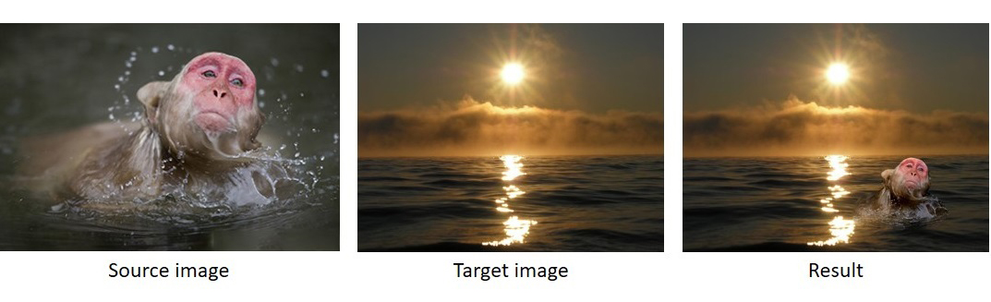
Data Preparation / Preprocessing
Imbalanced data: defect vs no-defect frequency?
Imbalanced data strategies: upsampling, downsampling, class weights
Common image normalization and data augmentation techniques
Normalize image data (0-255 -> -1 - +1)
Rotations
Cropping
Scaling
Flipping
Translations
Color space transformations
Noise injection
Synthetic defects with poisson image editing?

Slide 15
Models
We probably need all of them:
(Multiclass) image classification: CNNs, AlexNet, VGGNet, and ResNet
Panoptic segmentation (semantic, instance): U-Net, EfficientPS, UPSNet, VPSNet, EPSNet, FPSNet (https://arxiv.org/ftp/arxiv/papers/2111/2111.10250.pdf)
Object detection: Faster R-CNN, YOLO (You Only Look Once), and SSD (Single Shot MultiBox Detector), Mask R-CNN
Are there already general networks for rust, corrosion, crack detection?
Transfer learning
Use machine learning platforms to adapt those model for your purposes (Transfer Learning. (Amazon Rekognition, Amazon Lookout for Vision, Google Visual Inspection AI, Azure AI Vision, Azure AI Custom Vision, HuggingFace)
(There are models that fuse 2d with 3d data, but they are very complex in all manners [model complexity, data preparation, labeling, etc.] and not ready to use, especially for our use case with multiple images. Are there NERF like classifications models?)

Slide 16
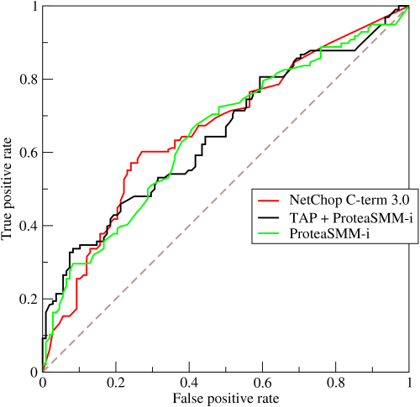
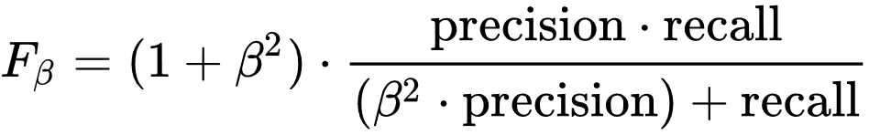
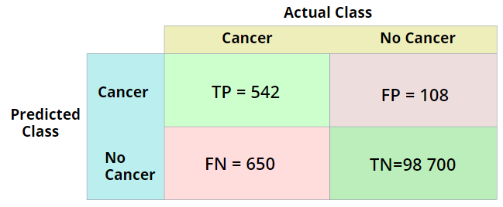

Metrics
Image classification
AUC of ROC (bad with imbalanced data)
PR-Curve (precision recall)
Fbeta score, F1 score (precision and recall), prioritize with beta
Segmentation, Detection: intersection over union (IoU)

Slide 17
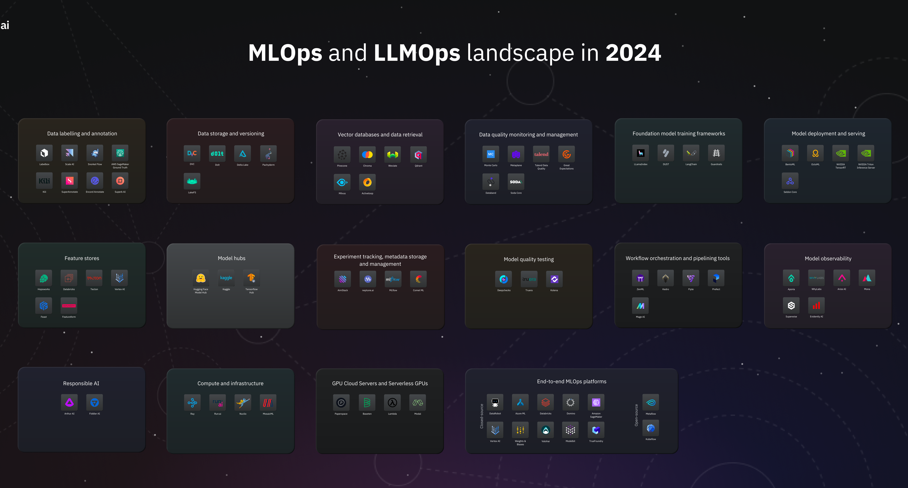
Tools

Slide 18
Tools
TF vs PyTorch:
Pytorch is much more popular and used more in research and easier to learn and debug, more libraries (3d, language extensions), closer to research and academia, >90% papers with code, slightly less optimized gpu execution
TF offers better deployment, distribution, more optimized, static computation graph,
Simply use both, whatever is more comfortable in the current situation. Our model input are just images, so nothing complicated.
MLOPS (https://mad.firstmark.com/)
ClearML
MlFLow
Kubeflow (Kubernetes)
Neptune
Weights and Biases
TensorBoard
Just take Amazon SageMaker or Azure and see what’s missing?
Experiment tracking: no experience, we used git commits + config files
Model serving: maybe no API necessary because models are part of a larger software package

Slide 19
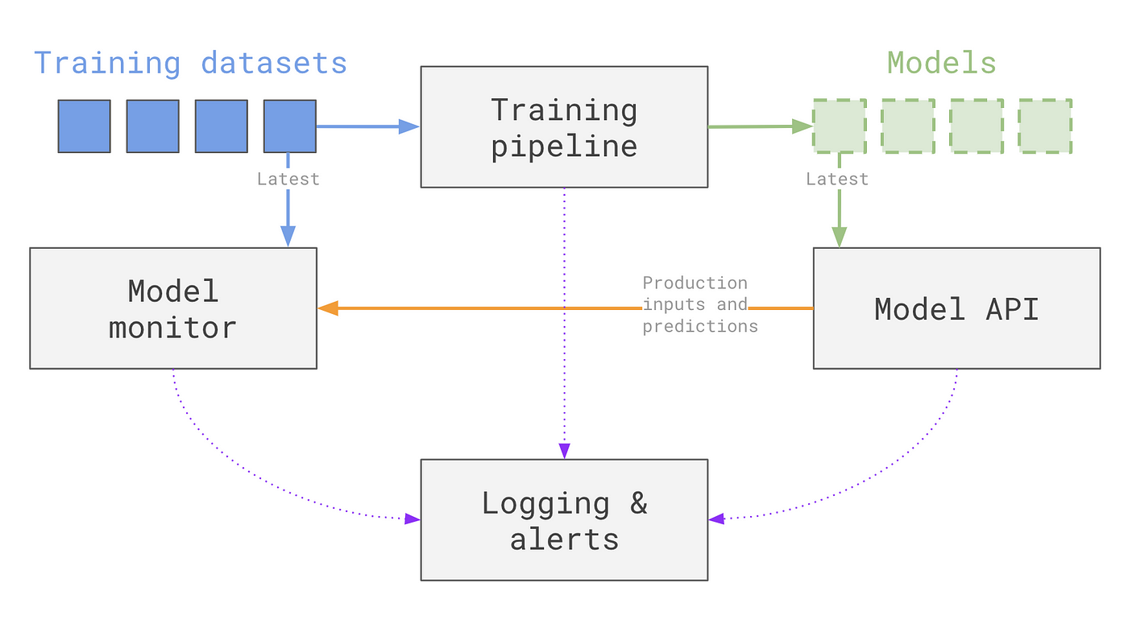
Pipeline
Treat model drift:
concept drift, example: new defect or change of how a defect looks like
data drift: change in raw data, seasonal data, different cameras, different drone routes etc..
upstream data drift: change in data preprocessing of raw data
Detect model drift
Inspect the evaluated data before relearning
Retrain with new and validated data and track metrics
All data is saved on the server. Image data is assigned to a single power post. So, we can track the condition over time and learn to predict or identify problems earlier.

Slide 20
Future
More specialized algorithms for object and defect detection / classification (data and knowledge driven agorithms)
Predictive Maintenance: predict and detect defects before they even happen, optimize preventive maintenance

